Slide 1
Intro to CSS
Mack 2021

Slide 2
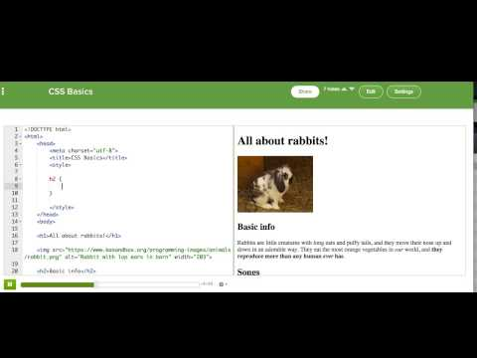
CSS Basics

Slide 3
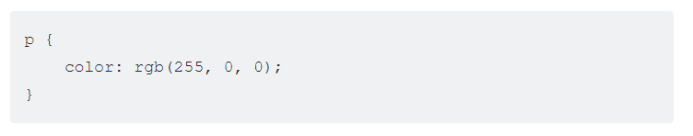
Quick tip: Selecting by tag name
As you just learned, we use CSS rules to select elements on a web page so that we can then style those elements.
The way we tell our CSS rule which HTML elements to style is by using selectors. There are many types of selectors that we'll cover later, but here we just want to review the one we showed in the talk-through: the element selector.
The element selector selects HTML elements based on their tag names. Each HTML element—<h1>, <p>, <li>, <body>—and any other HTML element can be selected with CSS by using the tag name without the angle brackets (< and >). For example, you can select all of the <p> tags in your webpage by using the element selector p. Here's a CSS rule that changes the color of each paragraph on a web page:

Slide 4
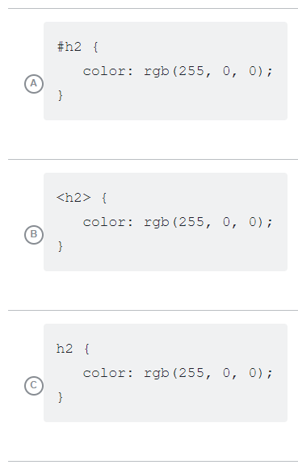
Let's check if that made sense. Which of these rules would select all of the <h2> elements on a page?
Notes:
🍐 This is a Pear Deck Multiple Choice Slide. Your current options are: A: A, B: B, C: C,
🍐 To edit the type of question or choices, go back to the "Ask Students a Question" in the Pear Deck sidebar.
C

Slide 5

Practice 1
For this first step, use the image tag to add an image to the page that shows the animal, and then fill in the paragraph with information about it
Let's have you make a webpage about an awesome animal, and color the webpage to look like it.

Slide 6

Practice 1
Now we want to add some CSS, but there's no <style> tag in this page yet. Add one inside the <head>, just below your <title> tag.
Let's have you make a webpage about an awesome animal, and color the webpage to look like it.

Slide 7

Practice 1
Now add a CSS rule to change the background of the whole page, inspired by the creature's colors.
Let's have you make a webpage about an awesome animal, and color the webpage to look like it.

Slide 8

Practice 1
Now add a CSS rule to change the color of the paragraph, inspired by the creature's colors.
Let's have you make a webpage about an awesome animal, and color the webpage to look like it.

Slide 9

Practice 1
Finally, add a CSS rule to change the color of the heading, inspired by the creature's colors.
Let's have you make a webpage about an awesome animal, and color the webpage to look like it.

Slide 10
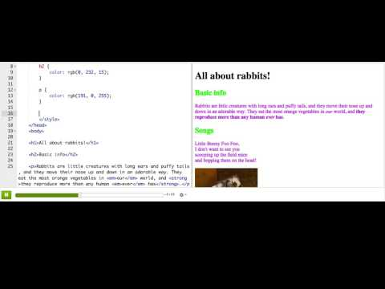
CSS: Selecting by id

Slide 11
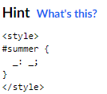
Practice 2
This webpage describes the favorite seasons of Olaf, a sun-loving snowman. Both of the <h2>'s have id's, but there are no CSS rules for styling them yet. Add 2 rules that color the headings.
Seasonal ids

Slide 12
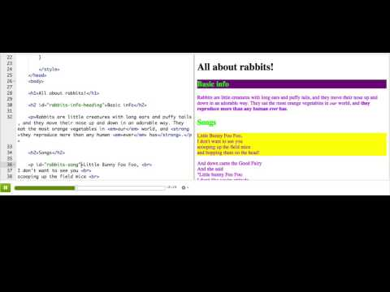
CSS: Selecting by class

Slide 13
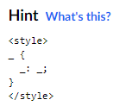
Practice 3
This webpage displays the lyrics for a song about apples and bananas. There are already classes on most of the words about apples and bananas, but there is no style for those classes yet. Add two style rules, one that sets a color for the 'apples' class and another that sets a color for the 'bananas' class.
Apples and bananas classes

Slide 14

Practice 3
The final line of the song has no classes on the <strong> tags! Add the 'apples' class to the first <strong> in that line, and the 'bananas' class to the second <strong> in it.
Apples and bananas classes

Slide 15
In CSS, how would you select all the <p> tags on a page?
Notes:
🍐 This is a Pear Deck Multiple Choice Slide. Your current options are: A: p { }, B: #p { }, C: <p> { }, D: .p { },
🍐 To edit the type of question or choices, go back to the "Ask Students a Question" in the Pear Deck sidebar.
A

Slide 16

In CSS, how would you select this heading by its id?
Notes:
🍐 This is a Pear Deck Multiple Choice Slide. Your current options are: A: .title { }, B: h1 { }, C: title { }, D: #title { },
🍐 To edit the type of question or choices, go back to the "Ask Students a Question" in the Pear Deck sidebar.

Slide 17
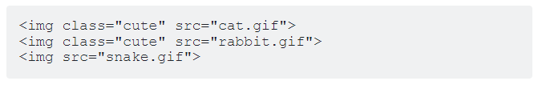
In CSS, how would you select only the images with class name "cute"?
Notes:
🍐 This is a Pear Deck Multiple Choice Slide. Your current options are: A: #cute { }, B: cute { }, C: img { }, D: .cute { },
🍐 To edit the type of question or choices, go back to the "Ask Students a Question" in the Pear Deck sidebar.

Slide 18
Practice 4
In this practice you'll use everything you've learned so far to create a travel website enticing viewers to visit an exotic locale. You should have images of what they'll see, lists of things to see and places to go, and paragraphs of enticing details. You should also use CSS to style the website, using a mix of the simple selectors you've learned.
Tip: Can't find the images you want in our image selector? You can also bring in images from Wikipedia. To do that, use a site-restricted Google search, then click "View image" on the result you like, and copy the URL into your <img> tag.
Travel webpage

Slide 19
Challenges

Slide 20
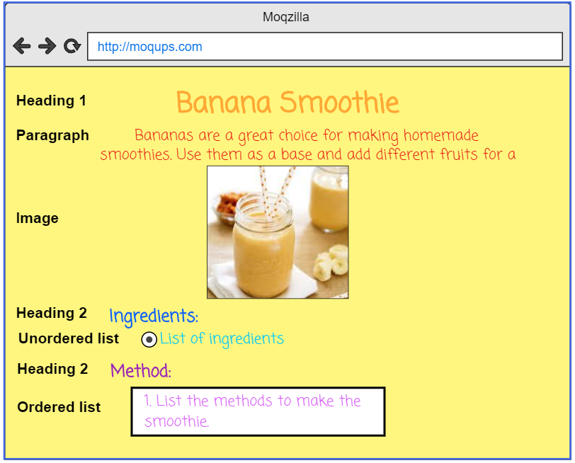


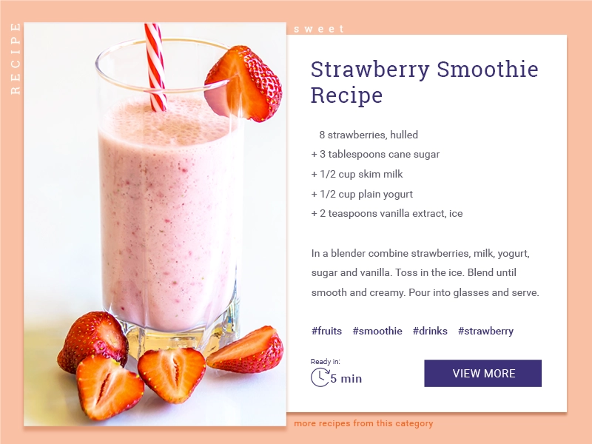
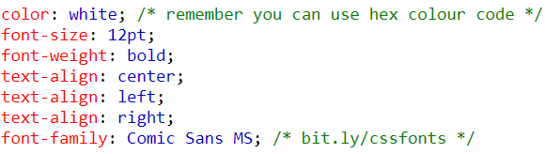

MAKE A RECIPE! (CSS)
START HERE
CREATE YOUR OWN RECIPE CARD USING HTML AND CSS!
Edit your recipe card using style.css
Using the CSS tags add format to your recipe; add background colour or picture, coloured font, size of image or text centered, left or right etc. Be creative!
In this activity, you will continue to edit your recipe . You will be introduced to six common CSS tags; font colour, size, family and alignment. Change background colour and image size.
Here’s a list of some CSS properties you can use:
FINISHED?
Publish your recipe on Google classroom.
Help a neighbour!
Use hex colour codes bit.ly/hexColour
Challenge yourself! Research how to add a link to a website or insert a YouTube video.
Credit to Code Club projects for this activity.
Notes:
Once pupils have made their recipe page using their HTML tags. Next pupils will be introduced to the CSS tags and how to write them; changing the element. This is a good opportunity to show hex colours as well. I would only show S1/2 pupils external CSS this is just a personal preference as I think it’s let confusing for pupils by having the two seperate pages and gets them into good practice. When I revist web design in S3 I would then go onto demonstrate internal css.
OBJECTIVES
By completing this activity, students will:
Become more familiar with editing css.
Be exposed to common css tags.
I would get pupils to open their HTML recipe page that they completed and I would open one that I have made as well to demonstrate. I would then draw their attention to the <link rel="stylesheet" href="style.css"> line on their page and go over what CSS is. I would point out that this is linking to the page style.css and that this is used to change the family font, font size etc. Just like the lesson before I would talk them through and demonstrate on my own html recipe what would happen with each type of css property illustrated on the slide. I would involve the class by asking them to give me a colour etc. I always demonstrate to pupils blue as it’s my favourite colour but tell them that I don’t actually like that particular shade so then go onto show them hex colour code that gets that excited usually. Or another good one to show them is gold as it just looks a bit orangey it’s not great so hex is a better option. I emphasis that hex colour codes can be used for colour of text as well not just the background of the page etc.
Task - Once I have demonstrated and we’ve had class discussion about the css properties I would then set the class the challenge. They have to now have font colour, background colour and an image to their recipe they can have a different colour of each piece of text if they wish it’s up to them. I really enjoy keeping tasks open for pupils to allow for creativity.

Slide 21
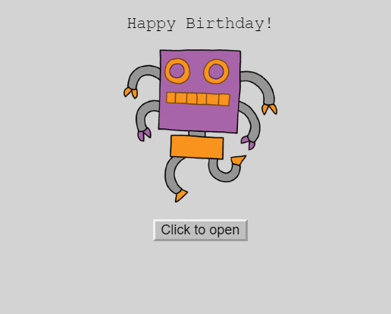
MAKE A CARD!
CREATE YOUR OWN CARD MANIPULATING HTML, CSS AND JAVASCRIPT!
START HERE
Open the Make A Card task
Edit the card to create something of your own. This could be a card, leaflet or invitation etc
In this activity, you will edit this happy birthday card. You will edit the html, css and javascript that will change this boring card into an exciting personalised card.
THINGS TO TRY
FINISHED?
Change the text on the page. - bit.ly/cssfonts
Change the image
Change the colour of text. - bit.ly/hexColour
Change colour of button. - bit.ly/hexColour
Change background of page. - - bit.ly/hexColour
Submit your link to your project on Google Classroom.
Help a neighbour!
Challenge yourself to add a gradient background colour bit.ly/cssGradient
Credit to Code Club projects for this activity.
Notes:
Pupils will be given the link to the basic happy birthday card. It will already have the basic code with image button, text etc on it. I would demonstrate to pupils the card opening and closing and show them the code and make a few adjustments. For example, if it said the colour grey I would change to a new colour etc or a new font etc. I would also ask pupils if they remembered from the previous lessons how to change colour to a specific shade? (just make sure you are not showing this slide as the answer, hex colour, is on the slide I’ve done this by mistake before : / ) I then ask if they can walk me through how to change the picture again to recap prior learning etc but also a useful reminder for pupils who might have forgotten or need some practice as it is a bit tricky. I would also touch on the new page for JavaScript and show them the code and what it does, stating it adds interactivity to a page but nothing more than that. Pupils are then set the task below. Task - Edit the code to create a new exciting card, this could be a valentines day card, halloween card, birthday card, good luck card etc.
OBJECTIVES
By completing this activity, students will:
Become more familiar with manipulating html and css.
This will allow pupils to become more confident in manipulating code.
Understand that JavaScript adds interactivity

